Slide 1

Health care services
HOSPITAL-NGO Services Database

Slide 2

PROBLEM STATEMENT
Many under privileged people cannot afford a proper medical treatment and are also not able to consult an expert doctor which results in deterioration of their health. In addition to this the other problem that we come across is the incapability of various NGO’s to capture the data of such people since they must collect this data manually which results in many underprivileged people not receiving proper health care timely. Hence, we have come up with a system where in we are projecting, how a hospital management system would work in collaboration with an NGO to work for the betterment of quality of life for needy people.

Slide 3


PROPOSED ENTITIES
Hospital
Employee
Doctor
Lab Assistant
NGO
Patient
Pharmacy
Consultation
Diagnosis
DocSpecialization
DiseaseType
TestType
Bill
Prescription

Slide 4

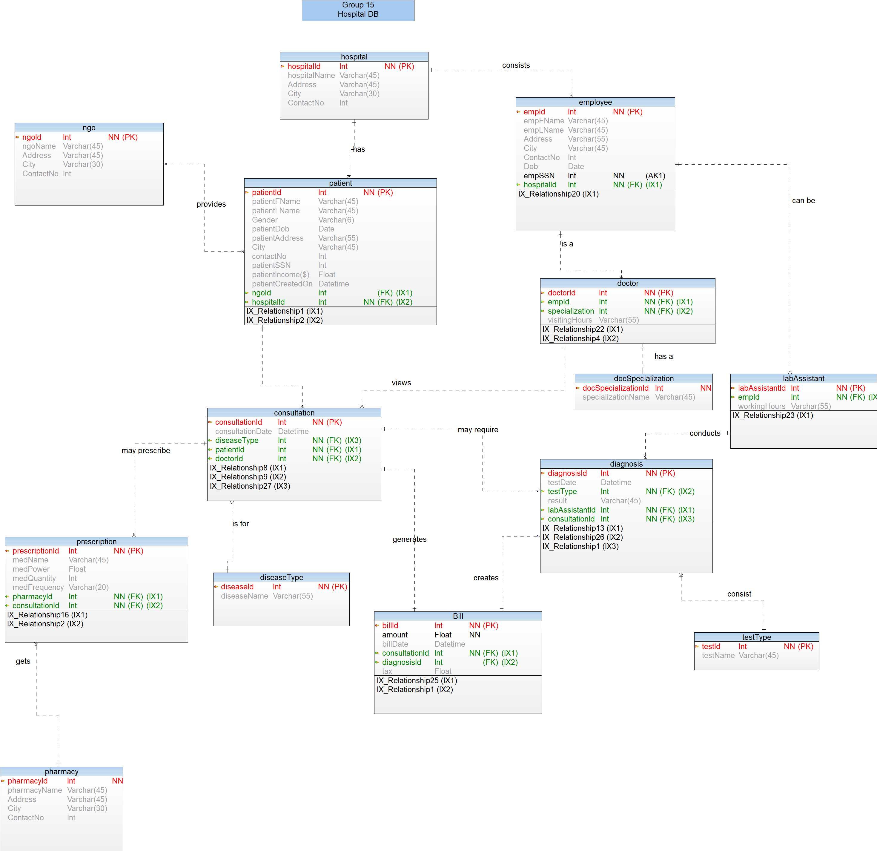

Slide 5
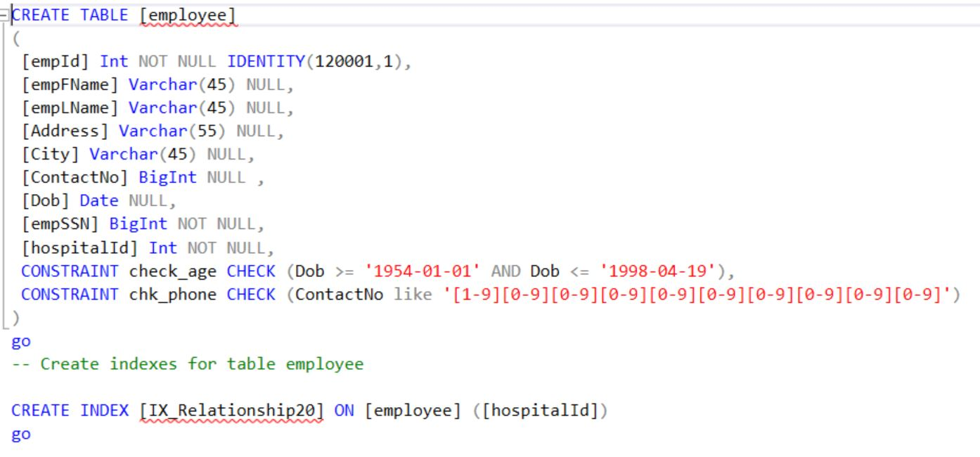
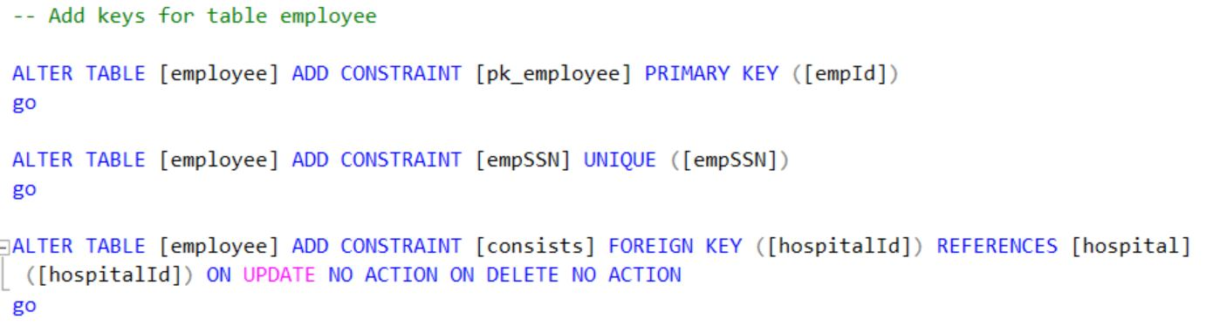
DDL SCRIPT- EMPLOYEE TABLE (ALONG WITH CHECK CONSTRAINTS)

Slide 6
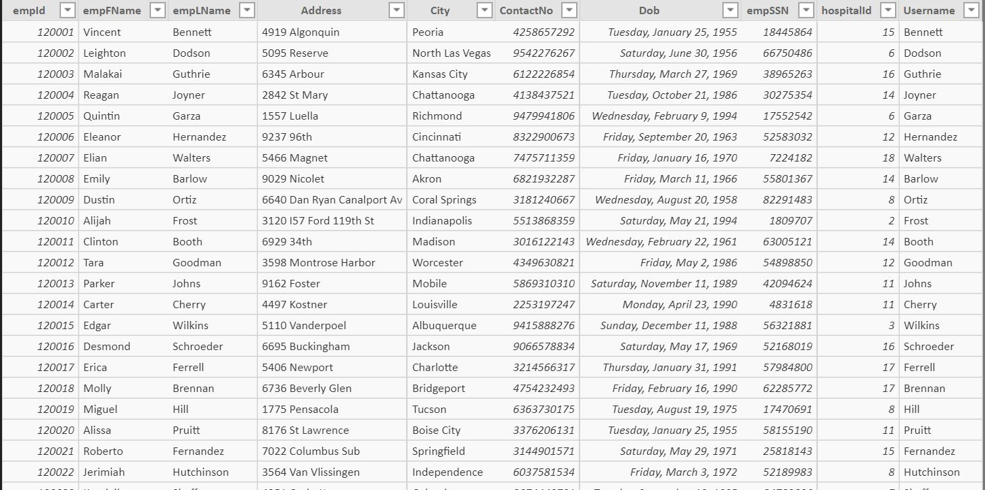
Screen capture OF OUR DATA- EMPLOYEE TABLE

Slide 7
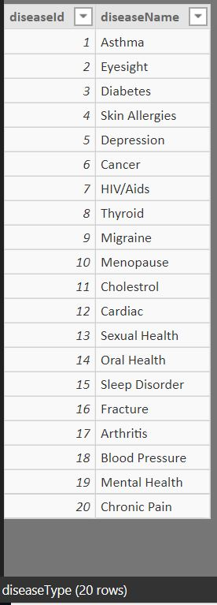
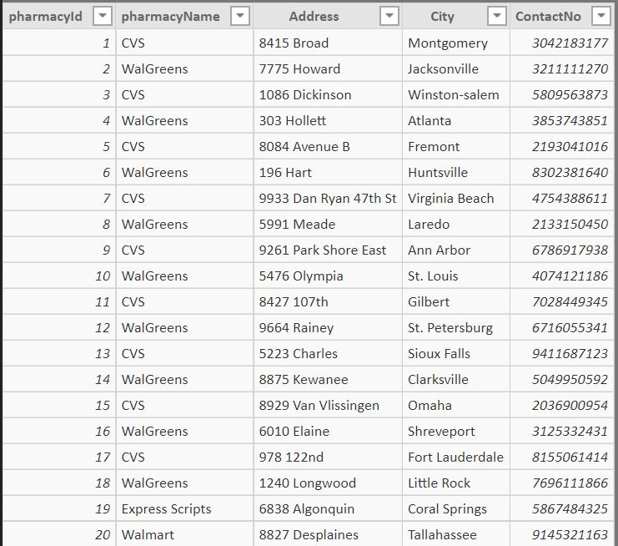
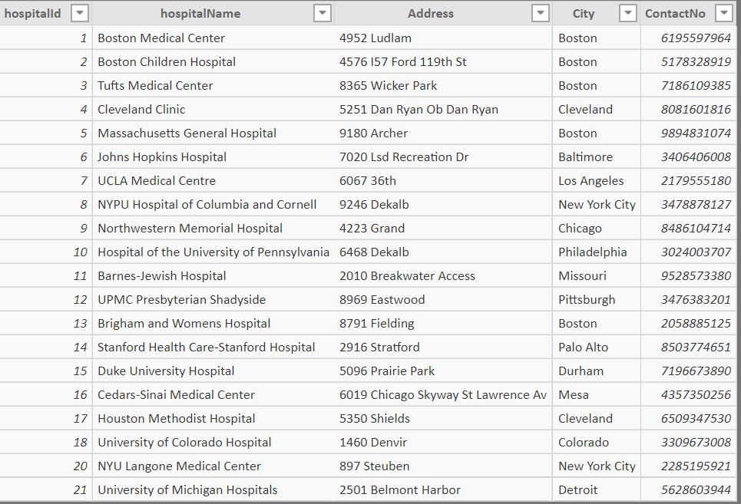
SOME MORE SNIPPETS OF OUR DATA – DISEASETYPE TABLE, PHARMACY table, Hospital table

Slide 8
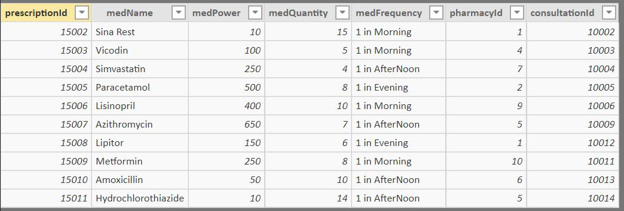
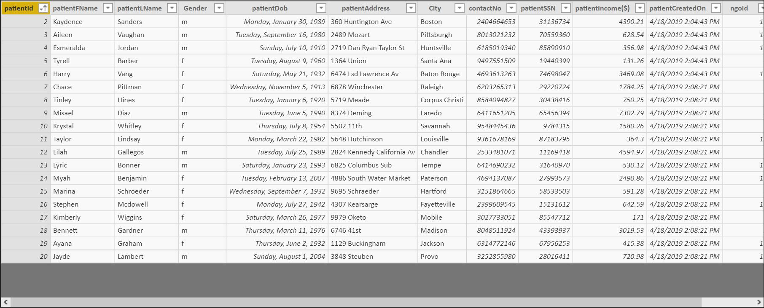
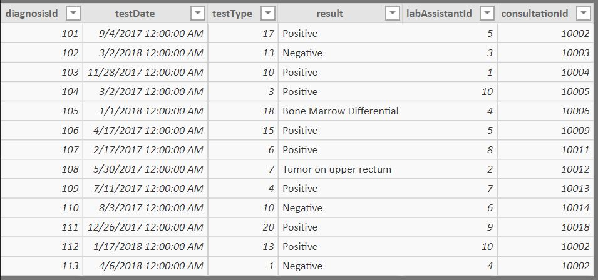
LITTLE MORE SNIPPETS OF OUR DATA – PRESCRIPTION TABLE, DIAGNOSIS table, PATIENT table

Slide 9
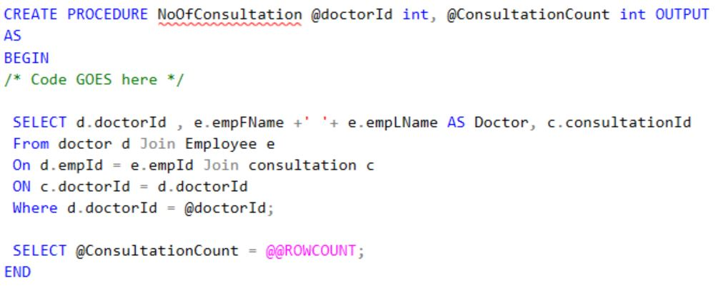
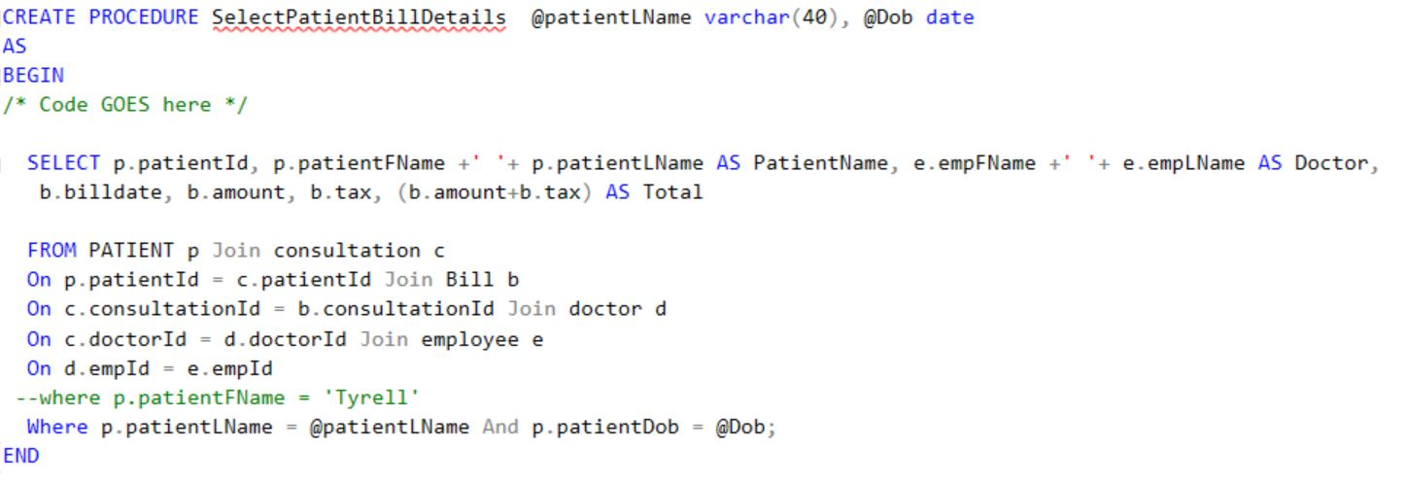
Stored procedures- output sp & input sp

Slide 10
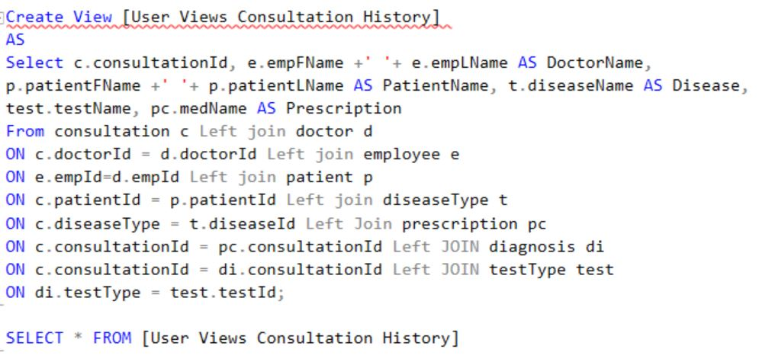
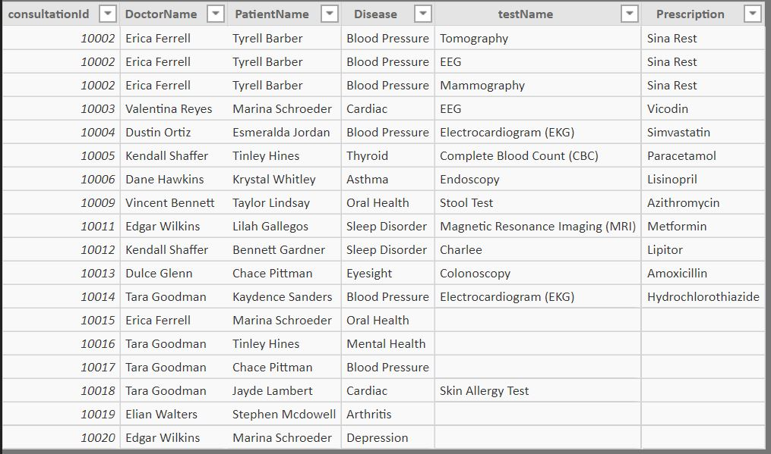
VIEW–FOR CONSULTATION HISTORY

Slide 11
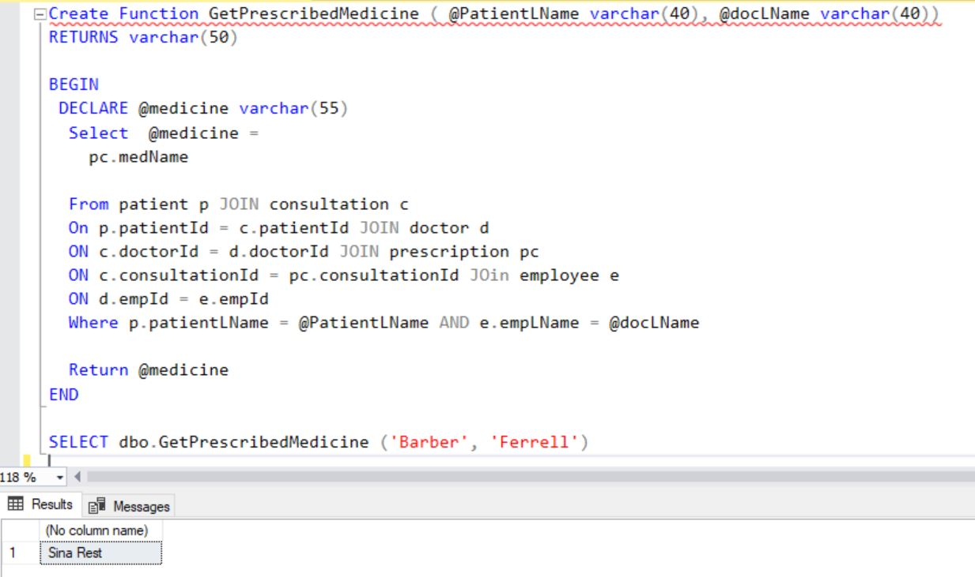
FUNCTION – TO FETCH MEDICINE FOR PARTICULAR PATIENT

Slide 12
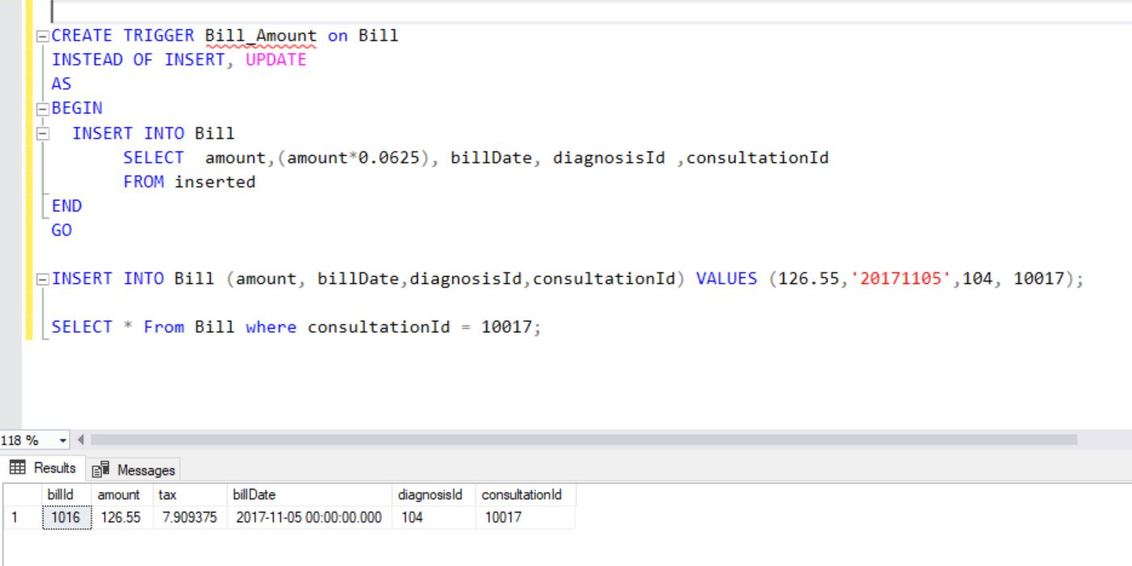
Trigger TO INSERT OR UPDATE TAX VALUE FOR BILLS

Slide 13
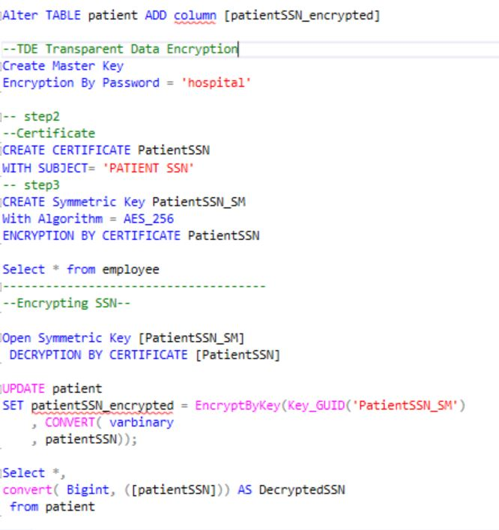
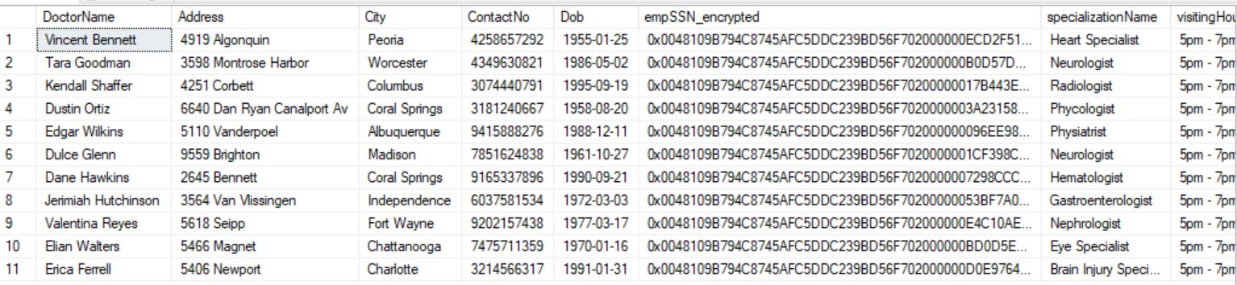
ENCRYPTION SCRIPT- encrypting ssn values

Slide 14
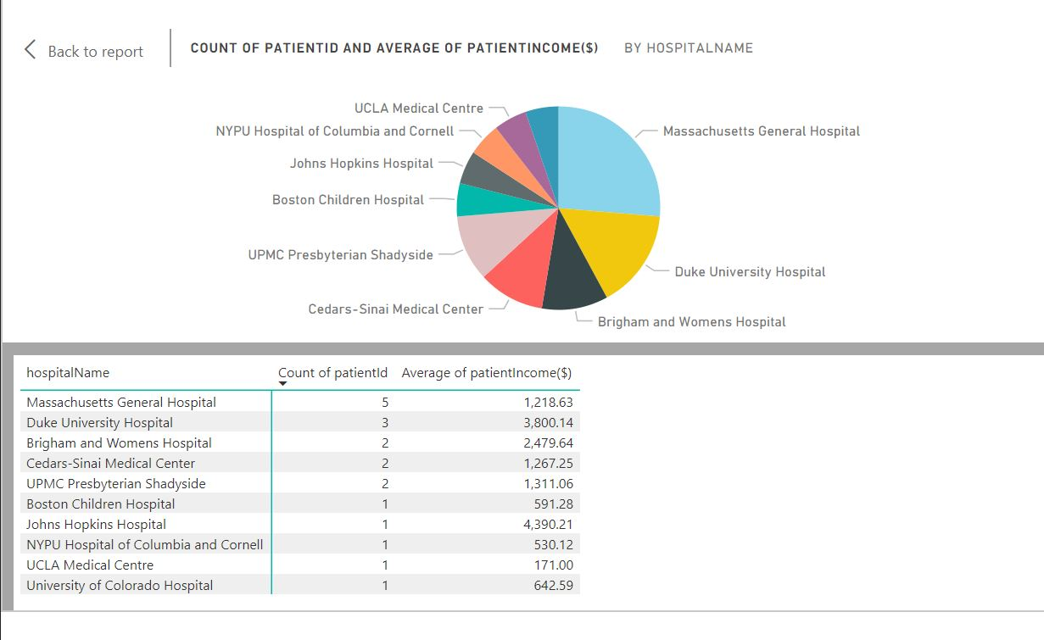
POWER BI REPORT–DASHBOARD for COUNT OF PATIENT PER HOSPITAL

Slide 15
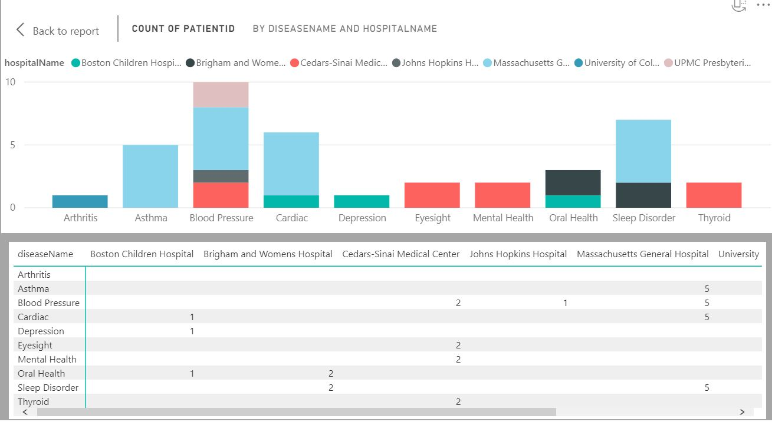
POWER BI REPORT–DASHBOARD for DISEASE SUMMARY IN DIFFERENT HOSPITAL

Slide 16
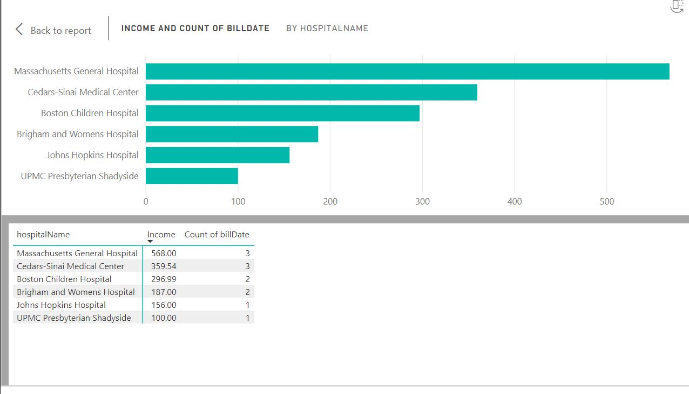
POWER BI REPORT–DASHBOARD for HOSPITAL INCOME

Slide 17
THANK YOU!

